Slide 1
Emotion Recognition using Convolutional Neural Network
Bharath roshan

Slide 2

Emotions are powerful information

Slide 3
Applications of Emotion Recognition
Emotion recognition in Health Care
Automotive industry and emotion recognition
Emotion recognition in video game testing
An industry that’s taking advantage of this technology is Health Care, with AI-powered recognition software helping to decide when patients necessitate medicine or to help out physicians determine who to see first and also for online healthcare.
Automotive industry and emotion recognition
The automotive industry is also applying emotion recognition technology, as car manufacturers around the world are increasingly focusing on making cars more personal and safe for people to drive. The latter is a chiefly attention-grabbing area and one that various companies have by now taken steps in testing and researching. In their pursuit to build more smart car features, it makes sense for car manufacturers to use AI to help them understand the human emotions. Using facial emotion detection smart cars can alert the driver when he is feeling drowsy.
Video games are designed with a specific target audience in mind and aim to evoke a particular behavior and set of emotions from the users. During the testing phase, users are asked to play the game for a given period and their feedback is incorporated to make the final product. Using facial emotion recognition can aid in understanding which emotions a user is experiencing in real-time as he or she is playing without analyzing the complete video manually.

Slide 4
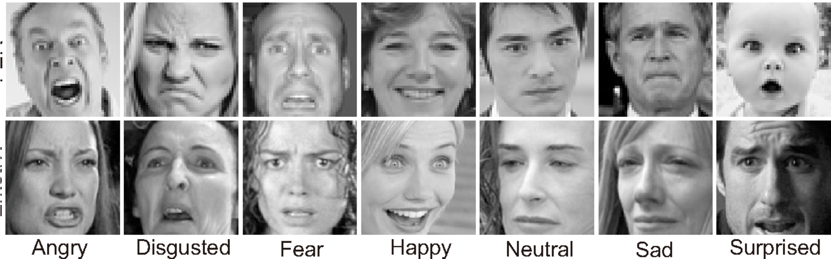
The dataset used in my paper is FER – 2013 which consists of 28,709 training images with 7 different classes and 7,178 images used for testing. This is labeled dataset.

Slide 5
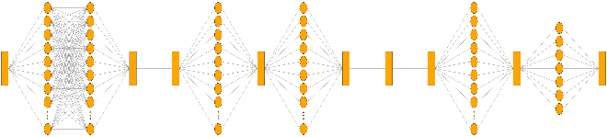
Algorithm used – CNN Architecture. It includes 4 Convolutional Layer and 2 Fully Connected Layer.
The Input Layer and the convolutional layers and 1 fully connected layer uses the “ReLU” activation function, and the output layer uses the “Softmax” activation function. To the input layer we are feeding of an image shape of 32 x 32 x 3 and there are 32 neurons present in this layer.

Slide 6

LOSS FUNCTION
The Categorical Cross Entropy is well suited to work on Classification Problems, and it is used for multi - class classification. It is normally used to quantify the difference between probability.

Slide 7
RECOGNITION
The Recognition part is using OpenCV, where we are passing on our saved model.
The HaarCascade Frontal Face is used to recognize the face in real time

Slide 8
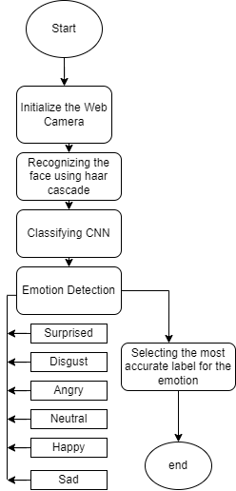

Slide 9


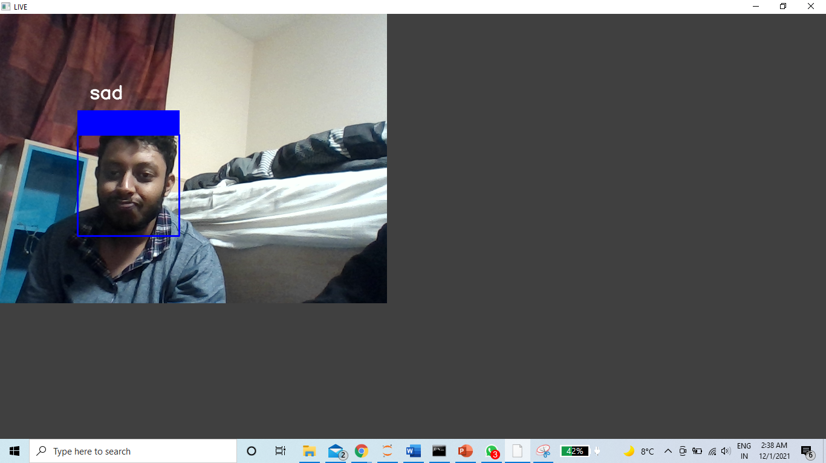

Slide 10
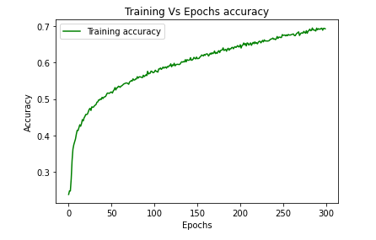
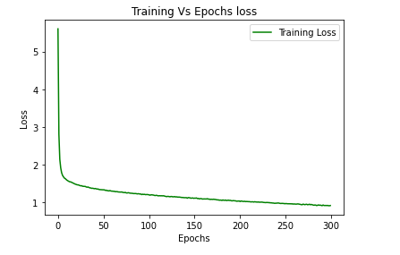
Results
Network was trained with a learning rate of 0.0001 and with 300 epochs and the accuracy obtained after the completion of the 300th epoch was 69.02%.

Slide 11
Conclutions
I had used 300 epochs to train this model from scratch . In the future, I plan to work on this using the Transfer Learning approach using different pre-trained model available such as VGG-19, ResNet, Inception V3. And improve the accuracy of this model. There are lot of research going on this area of study and lot more can be implemented in the Future with Speech Emotion Recognition etc. And this area is expanding good investment in more advanced computation power to train the model.

